Slide 1


EVEN Semester Project (part 2) Exam
AY 2018-2019
Group Members Names:
(1) Anand Singh (36)
(2) Hiresh Joshi (71)
(3) Meet Mehta (72)
Under the Guidance of : Mrs.Shiwani Gupta

Slide 2
Index
Introduction
Problem Definition
Existing work and its gaps
Proposed Work
Implementation
Results Analysis
Conclusion and future work
Publications
References

Slide 3
Introduction
The project idea emerged from the college itself when the results were taking too long to be displayed.
The backbone of the project is the methodology of Data Science and Data Mining.
The main purpose is to implement a realistic model that helps students to predict their grades.
The model predicts the forthcoming result of the respective student by a blend of both Past Data analysis ,Co-Curricular Activities & Extra-Curricular Activities and Present Student Behavior such as “Time spent daily in travelling(in hours)” & Time Spent Daily on social Media/TV ( in hours)

Slide 4
Problem Definition
Ever wondered why results are the most crucial part in our academic career?
‘Result prediction using Data Science and Behavioural Analysis’ helps to take into consideration, the past results of the students from all the previous 6 Semesters ,along with their Attendance of previous semester , accurate to the scale of 0.5. The scale can be positive or negative to the base pointer.
It helps to predict the pointer of Seventh or Eight semester only.
It integrates with the behavioural data provided by the user at real time, to give the approximate value of the pointer.
We have trained the model using one of the most crucial and independent algorithm of Machine learning that is Linear Regression.

Slide 5
Existing Work & it Gaps
Sr.no 1
Title: Predicting Student Performance using Advanced Learning Analytics
Author: Ali Daud , Naif Radi Aljouhani , Farhaat Abaas and Rabeeh Ayaz Abbasi
Description: To investigate aforementioned feature sets by collecting the scholarship holding students’ data from different universities of Pakistan. Learning analytics, discriminative and generative classification models are applied to predict whether a student will be able to complete his degree or not.

Slide 6
Gaps Identified In Sr No.1
The model only predicts whether the student will “pass” or “drop out”.
It makes use of student academic performance, family income & assets ,family expenditure and student personal information. It doesn't include “Behaviour Analysis”.
It doesn't include Attendance. etc
In this model the data set collected consists of “Scholarship Holding student’s” from different universities.
This model will be only beneficial for recruiting agencies.

Slide 7
Sr.no 2
Title:Early Prediction of Students Performance using Machine Learning Techniques
Author: Anal Acharya, Devadatta Sinha
Description: Early prediction of student results for identifying the “weak” students so that some form of remediation may be organized for them. In this paper a set of attributes are first defined for a group of students majoring in Computer Science in some undergraduate colleges in Kolkata

Slide 8
Gaps Identified In Sr No.2
The model only predicts which class the student falls ranging from “O – F”
Well this model has some features for behaviour analysis such as “No. of hours studied” but it lacks.
It does not include “co-curricular” or “Extra-Curricular” Activities of the student
It doesn't consider students whose mid-term scores are missing in the record

Slide 9
Proposed Work
The Result based predictive model expects to as accuracy in very limited number of classes. we are going to make an application-based model, predicting their forthcoming results.
The backbone of the project is the methodology of Data Science and Data Mining.
The use of Linear Regression algorithm helps in determining the actual results
Using this prediction system students will get idea about how much amount of time they should give for getting the desired result, which will allow him to spend their valuable time in other activities.

Slide 10
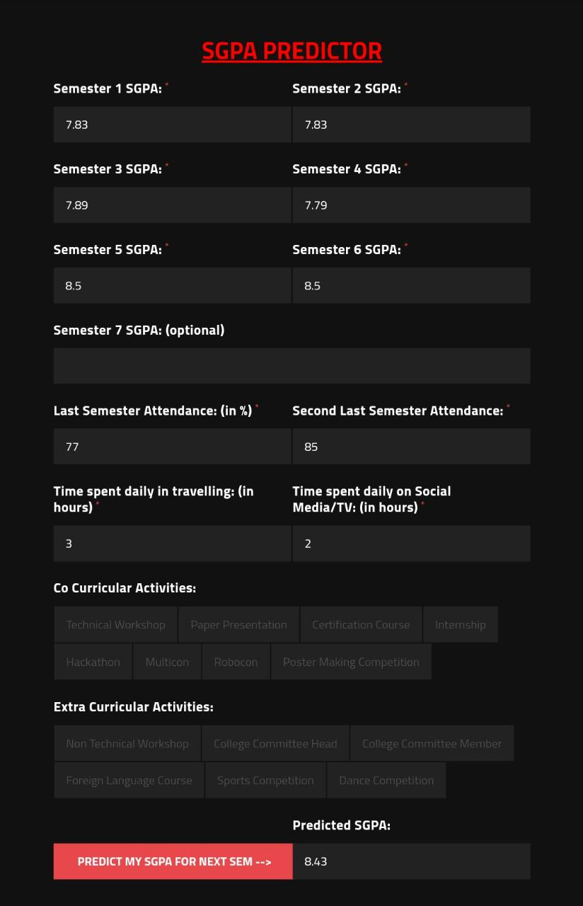
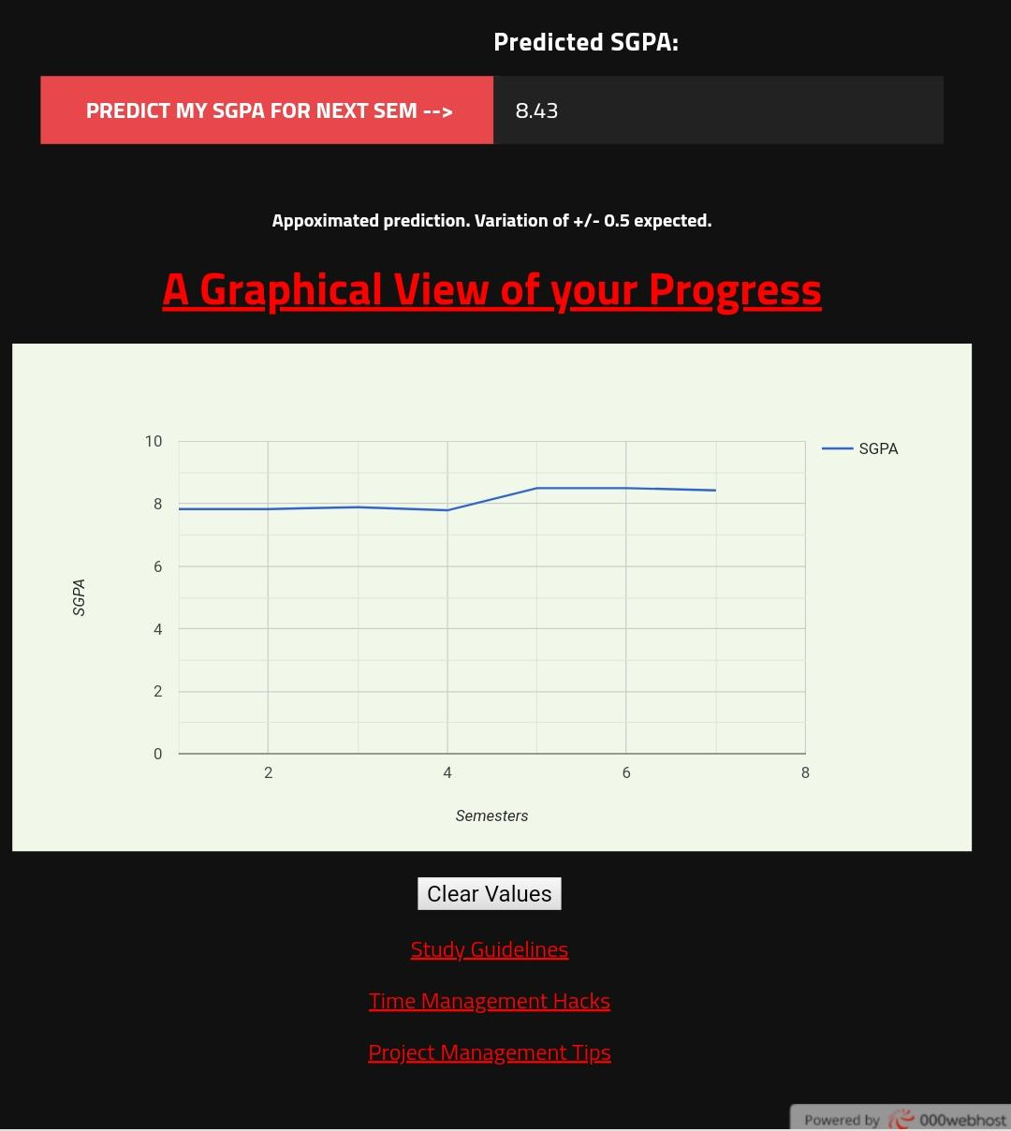
Implementation

Slide 11
Result Analysis
This project aims at predicting the pointer of the Engineering students for 7th and 8th semester respectively.
It can be inferred from the above results that the model is trained and is hosted on the Google ML Cloud Server.
The google ML Server is responsible for providing processing power. Apart from this, the User Interface of the project is built.
Students can insert their Academic details and predict their pointer. There are certain considerations for inserting the pointer.
Also, it can be inferred that the predicted pointer is less than or greater than 0.5.

Slide 12
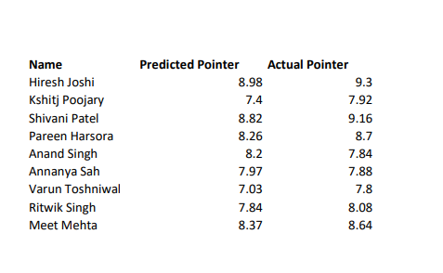
For analysing the result, we had made a small comparison report of few students from the class and added their last semester pointer and predicted pointer. The result is shown below:
Inputs taken from Students :

Slide 13
Conclusion and future work
Predicting students’ performance is mostly useful to help the educators and learners improving their learning and teaching process.
The project provides user input to the students for entering their pointers, attendance and behavioural patterns, but it may happen that the student may enter vague data, or data that is not approximate to their original values. Thus, an approximate range of 0.5 is tolerated.
The project can be built on a larger scale in future by training the model with more number of data sets and more tuples.
Also using various other classification algorithms such as Linear Regression can improve the accuracy of the project.

Slide 14
Publications
Published in IRJIET (International Research Journal of Innovations in Engineering & Technology) e-ISSN: 2581-3048, Manuscript ID:IRJIET303002(14/03/2019)

Slide 15
References
Paper
[1] ‘Amjad Abu Saa’ , Educational Data Mining & Students’ Performance Prediction, (IJACSA) International Journal of Advanced Computer Science and Applications, Vol. 7, No. 5, 2016
[2] ‘Byung-hak Kim, Varun Ganpathi’ , Students Performance prediction using Deep Learning
[3] ‘RR Kabra and R.S Bichkar’ , Performance Prediction of Engineering Students using Decision Trees , International Journal of Computer Applications (0975 – 8887) Volume 36– No.11, December 2011
[4] ‘ M Ramaswami and R Bhaskaran’ , A CHAID Based Performance Prediction Model in Educational Data Mining, IJCSI International Journal of Computer Science Issues, Vol. 7, Issue 1, No. 1, January 2010
Websites
[1] https://luis-goncalves.com/what-is-scrum-methodology/ (12/10/18)
[2] https://www.sciencedirect.com/science/article/pii/S1877050915036182 (12/10/18)
[3] https://www.analyticsvidhya.com/blog/2017/09/understaing-support-vector-machine-example-code/ (14/10/18)
[4]https://medium.com/deep-math-machine-learning-ai/chapter-4-decision-trees-algorithms-b93975f7a1f1 (14/10/18)
[5] http://www.statisticssolutions.com/non-parametric-analysis-chaid/ (12/10/18)

